Slide 1

Python Workshop
Session 1

Slide 2
What we hope to achieve from these sessions
Gain an understanding of Python
Be able to use our understanding of Python to create functional code
What we hope to achieve today
Gain an understanding of the fundamentals of Python and how they can be used

Slide 3
Content
Data Types
Variables
Syntax
Conditionals
Loops
Arrays
Functions

Slide 4
Data Types
int – Integer values (5, 100, -42)
float – Decimal numbers (1.1, 3.14, -45.6)
str – Strings or texts (“Hello”, “H”, “Hello my name is Example Name”)
bool – Boolean values (True , False)
list – Ordered collection of values ([1,2,3,4], [-55,1,555])
dictionary – Key/Value pairs ({“Name”:”Dave”,”Age”:15})
tuple – Unchanging ordered collection ((10, 20, 30), (40, 90, 120))
Set – Unordered collection of unique values ({1,2,3}, {-9,12,97})

Slide 5
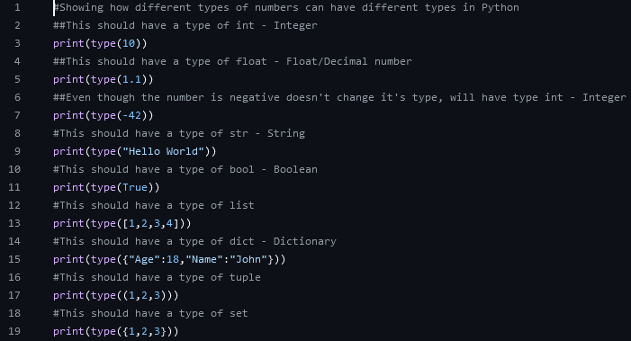
Data Types Example

Slide 6
Variables
Def = Store data that can be used and changed in a program
Python auto assigns a data type depending on what is being stored it doesn’t need to be defined
Naming rules
Must start with a letter or underscore (_)
Can contain letters, numbers, and underscores (my_var, age1)
Case sensitive: name and Name are different variables
Works by points to a point in memory almost like a sign

Slide 7
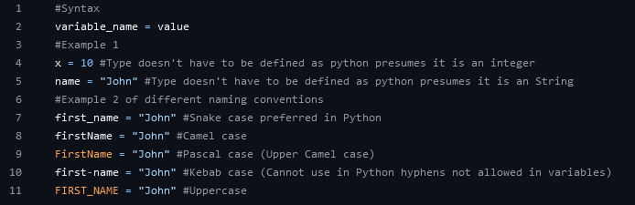
Variables Example

Slide 8
Syntax
Def = Syntax refers to set of rules that defines how Python code should be written and structured
Key Syntax Rules
Indentation
Uses indentations to define code blocks compared to Java or C# which uses brackets
Common error = IndentationError occurs when indentation level is inconsistent
Comments
Use comments to explain code
Single comments use (#)
Multiple line comments use (“”” stuff “””)

Slide 9
Syntax Continued
Case Sensitivity
Which means that variable declarations and usage need to be the same or else you will be referencing different variables
Eg: variable and Variable are two different variables
Avoiding Errors
Numerous ways you can make errors in Python
Not using proper indentation, Spacing, and correct use of Syntax
Although Python will tell you where you are making the errors and what is the error type and causing it

Slide 10
Conditionals (If-Else)
Def = Control flow of program based on conditions
Done by stating a condition what will happen if true else do something else
Operators
Comparison
Equal to (==), Not equal to (!=)
Greater than (>), Less than (<)
Greater than or equal (>=), Less than or equal (<=)
Logical
and → if both statements true will say true else false
or → if either or both statements true will say true else false
not → opposite of current statement, true statement will be false and vice versa

Slide 11
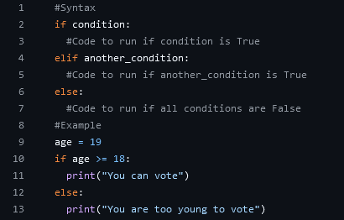
Conditionals Example

Slide 12
Loops
Def = Repeat a block of code multiple times which you can define
Types
For loop = Iterate over a sequence a set number of times
While loop = Repeats as long as the condition is true
Loop controls
break – exit a loop when an external condition is met
continue – end current iteration in loop and continues to next iteration
pass – skips the current block of code often used as a placeholder

Slide 13
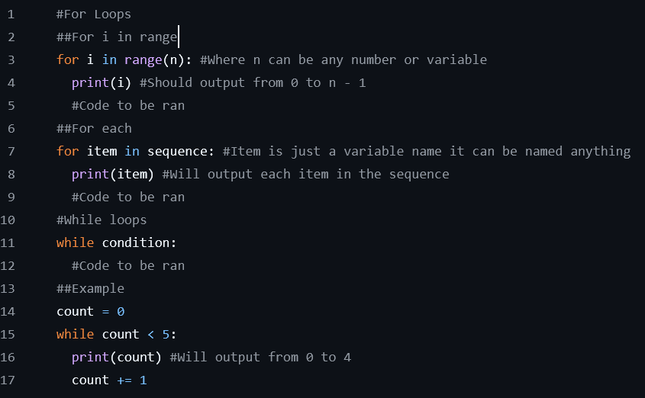
Loops Example

Slide 14
Arrays (Lists)
Def = Ordered collection of elements that can be modified
In most programming language the first position in an Array is 0 and the last position is the length of it - 1
Operations
Example array: fruits = [“Apple”, “Cherry”, “Plum”, “Tomato”]
Access elements – fruits[0] → “Apple”
Append (Add to end) elements: fruits.append(“orange”)
Remove elements: fruits.remove(“Plum”)
Remove elements by index(position): fruits.pop(2)
Slicing: fruits[1:3] → [“Cherry”, “Plum”, “Tomato”]

Slide 15
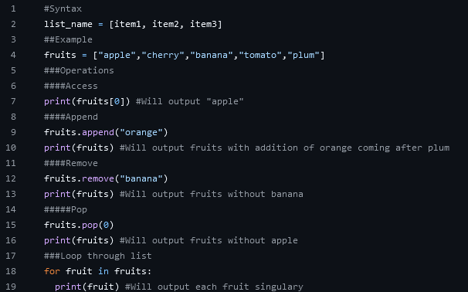
Arrays (Lists) Examples

Slide 16
Functions
Def = Block of reusable code that performs a specific task
Key points
Use def to define a function
Functions can accept parameters (inputs) and return values
Functions help to organise code and reduce repetition

Slide 17
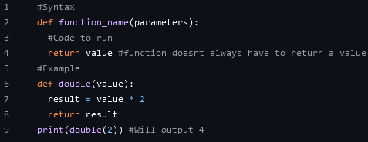
Functions Examples

